Slide 1

Govt. Chandulal Chandrakar Arts & Science College Patan
TYPES OF PROGRAMMING LANGUAGES
GUIDED BY
MISS NIDHI SINGH
SUBMITTED BY
RESHMI

Slide 2
CONTENTS:-
DEFINITION
TYPES OF PROGRAMMING LANGUAGE
Low Level Language
High Level Language
CONCLUSION

Slide 3
DEFINITION:-
Artificial Language
Designed To Communicate Instructions To a Machine
Used To Create Programs That Control The Behavior Of a Machine.

Slide 4
TYPES OF PROGRAMMING LANGUAGES:-
LANGUAGES
Low level language
High level language
Machine language
Assemble language
Procedural oriented language
Problem oriented language
Natural language

Slide 5
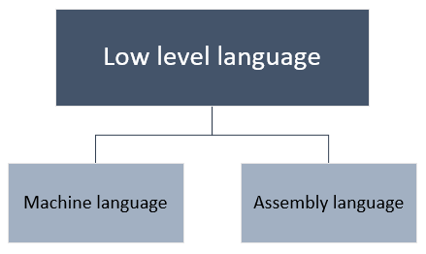
LOW LEVEL LANGUAGES:-
Low level language are those language which are close to machine language.
It is used for developing new operating systems.
It is fast to process as machine code is near and returns the output.

Slide 6
1.MACHINE LANGUAGE:-
Directly run on CPU.
Series of bits like 0 & 1.
Not portable
2. ASSEMBLY LANGUAGES:-
Less error prone.
Coding easier than machine language.
Replaces 1 & 0 with English instruction.

Slide 7
HIGH LEVEL LANGUAGES:-
Easy for humans to write compared to low level language.
Code is easy to read understand & modify
Same code will work on many different machine.
High level language
Procedural oriented language
Problem oriented language
Natural language

Slide 8
1. PROCEDURAL ORIENTED LANGUAGES:-
Pop the emphasis is on functions rather than data. & data is also not secured in this approach.
So the data is secured from the outside world.
2. PROBLEM ORIENTED LANGUAGES:-
Develop PL domain very close or identical to application domain.
Large execution gaps.

Slide 9
3.NATURAL LANGUAGE:-
Machine translation
Information retrieval
Sentiment analysis.
CONCLUSTION:-
Programming is writing instructions for a computer to follow.
Various language have been invented over the years to programmers.

Slide 10
THANKYOU

